Slide 1
NEW YORK CENSUS EMPLOYMENT IN TECHNOLOGY TRENDS
Zoya Raja, Gabriel Molina, Jefferson Rosa, Christina Gomes
CST 4704 OL54

Slide 2
Introduction
This project has an objective to cross references the past census employment in technology, in New York.
This data analysis modeled the future trends of employment in technology in New York.
The data of the past census in employment in the areas of technology in New York are age, ethnicity, and gender. These databases were cross referenced to predict future trends in employment.
This was objective and analysis was executed through ETL, SSIS, SSAS, and SSRS Reports.

Slide 3
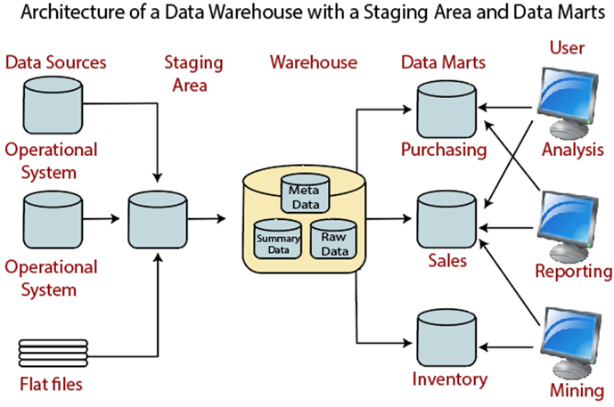
Data Warehouse Architecture:
Data Warehouse with a
Staging Area and Data Marts

Slide 4
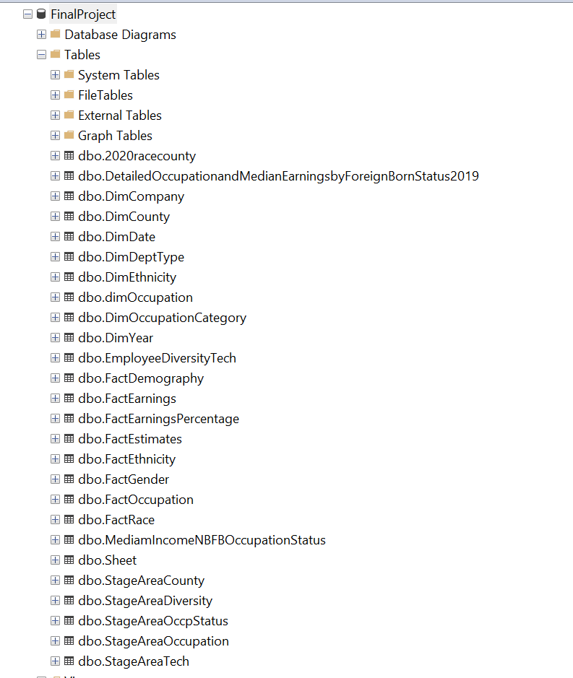
Database Warehouse:

Slide 5
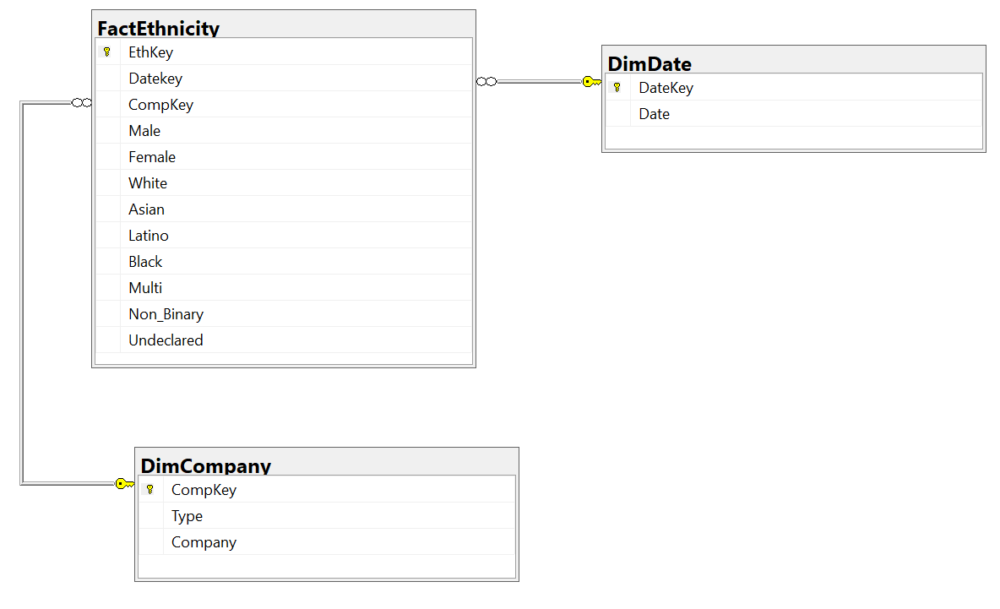
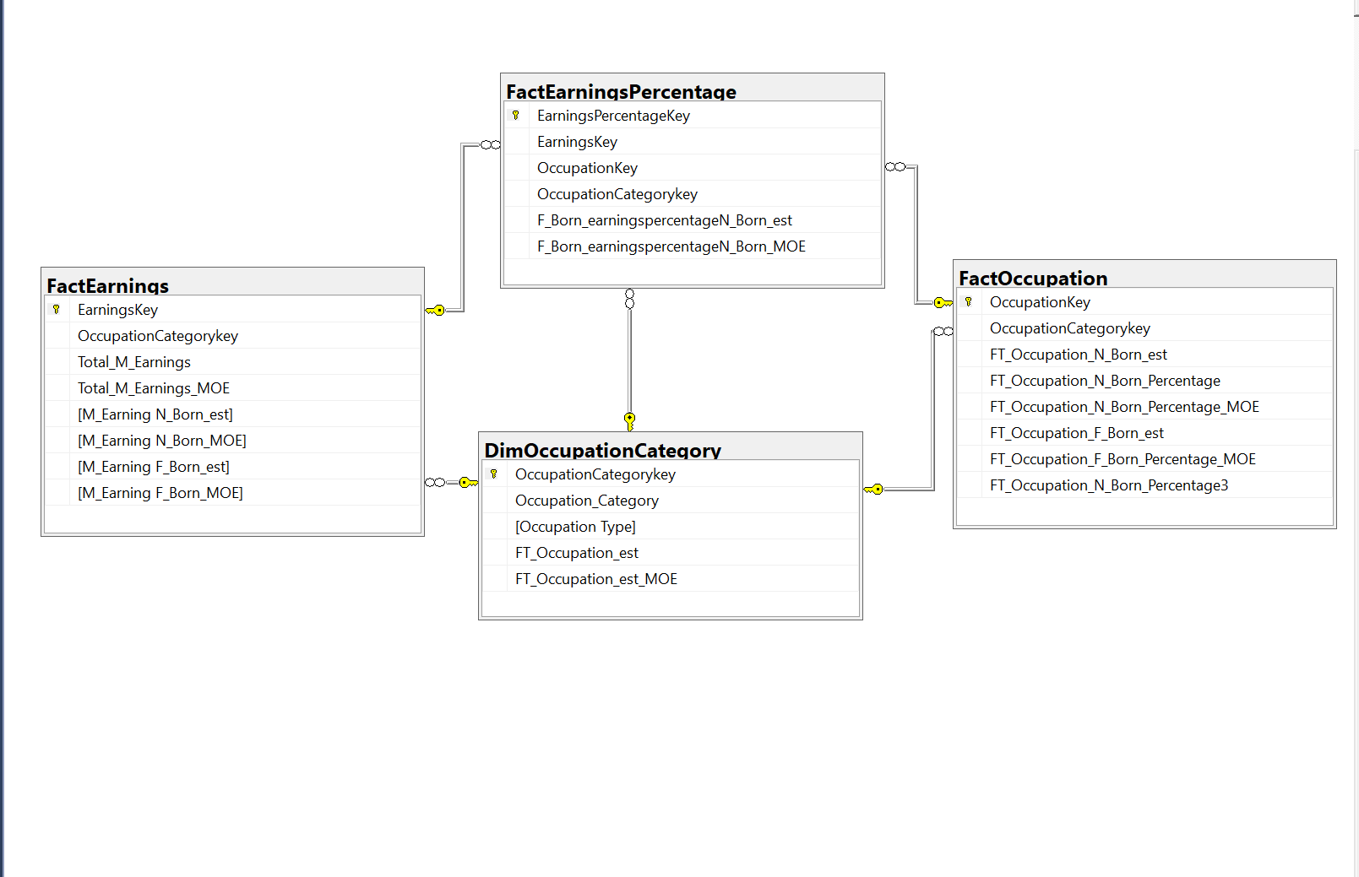
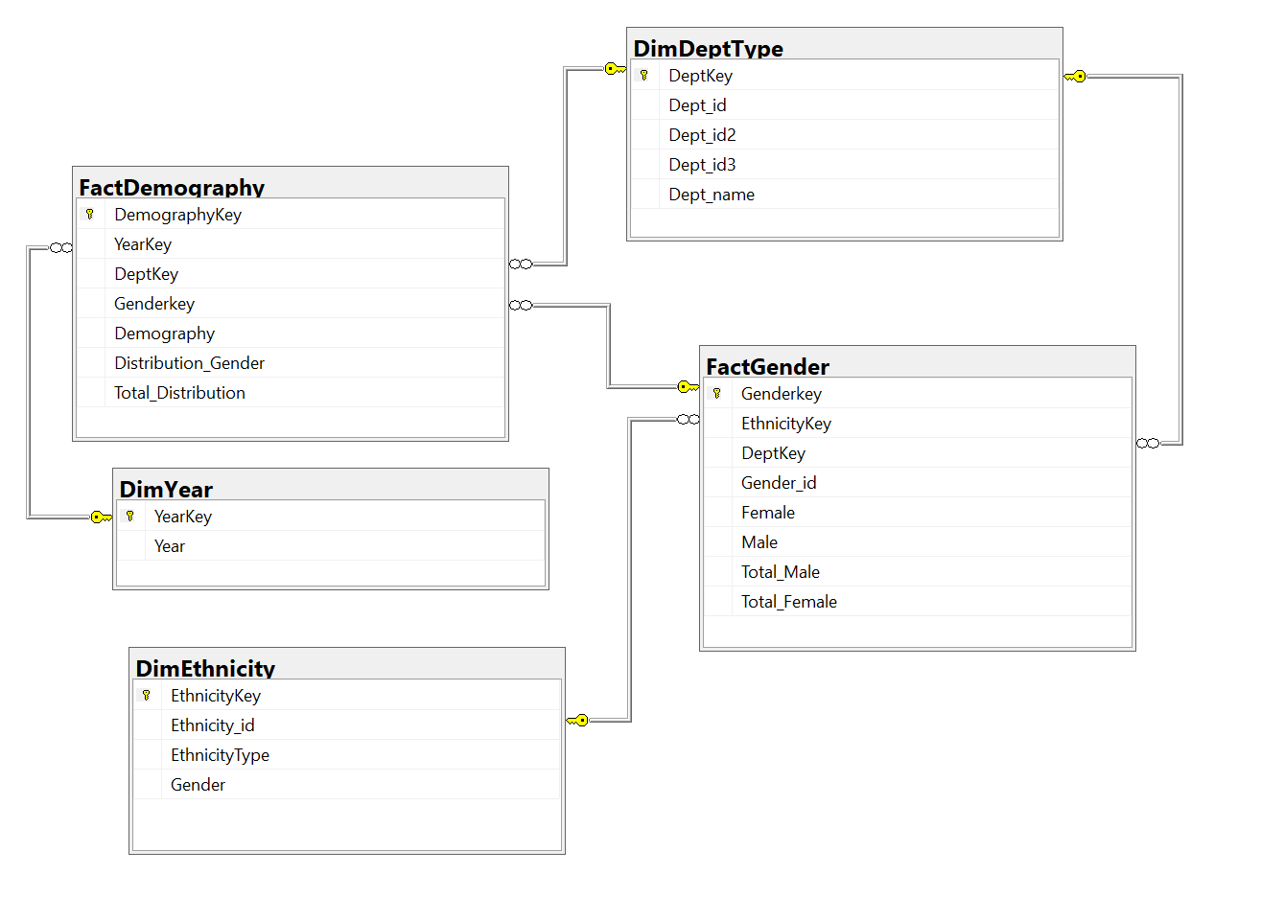
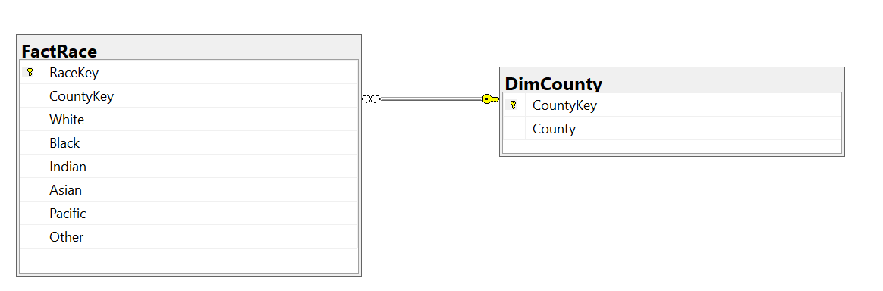
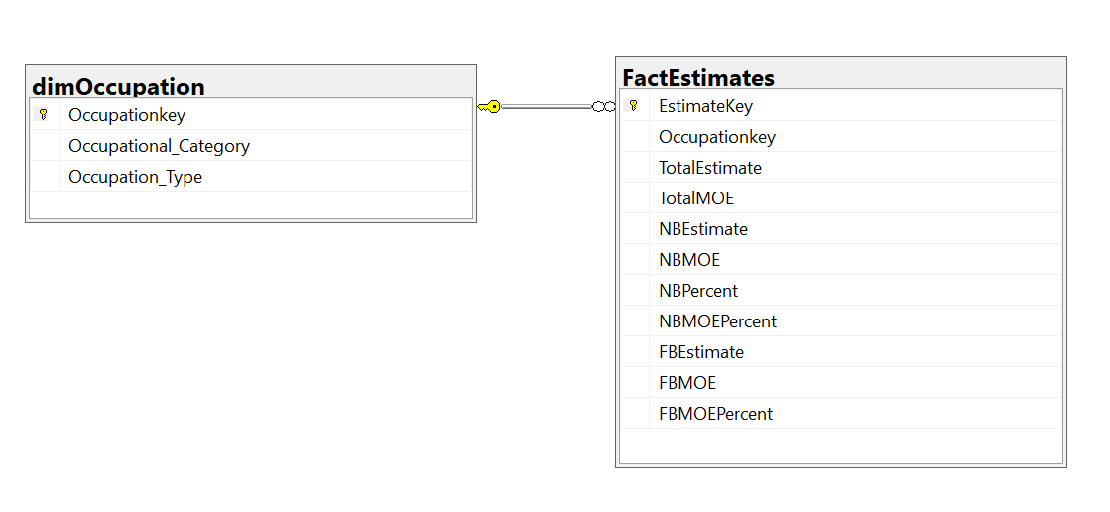
Database Diagram:
StageAreaOccupation
StageAreaDiversity
StageAreaCounty
StageAreaOccuStatus
StageAreaTech

Slide 6
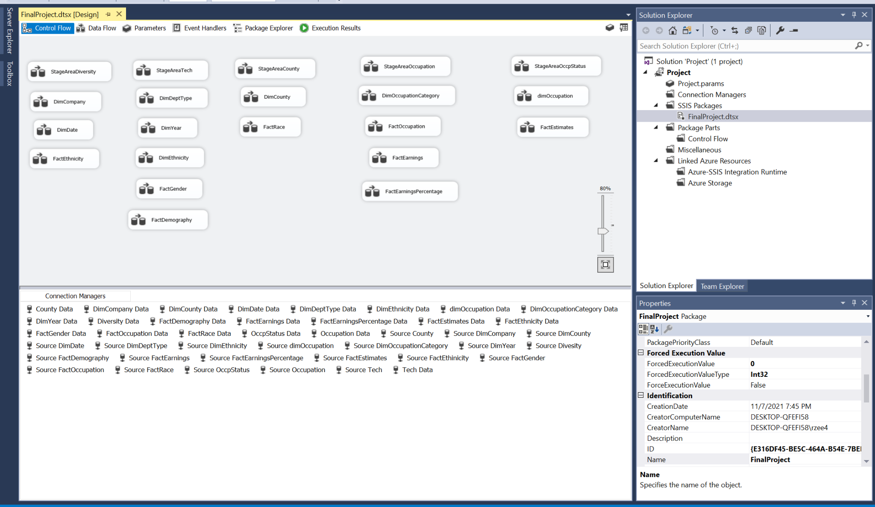
SSIS Design:

Slide 7
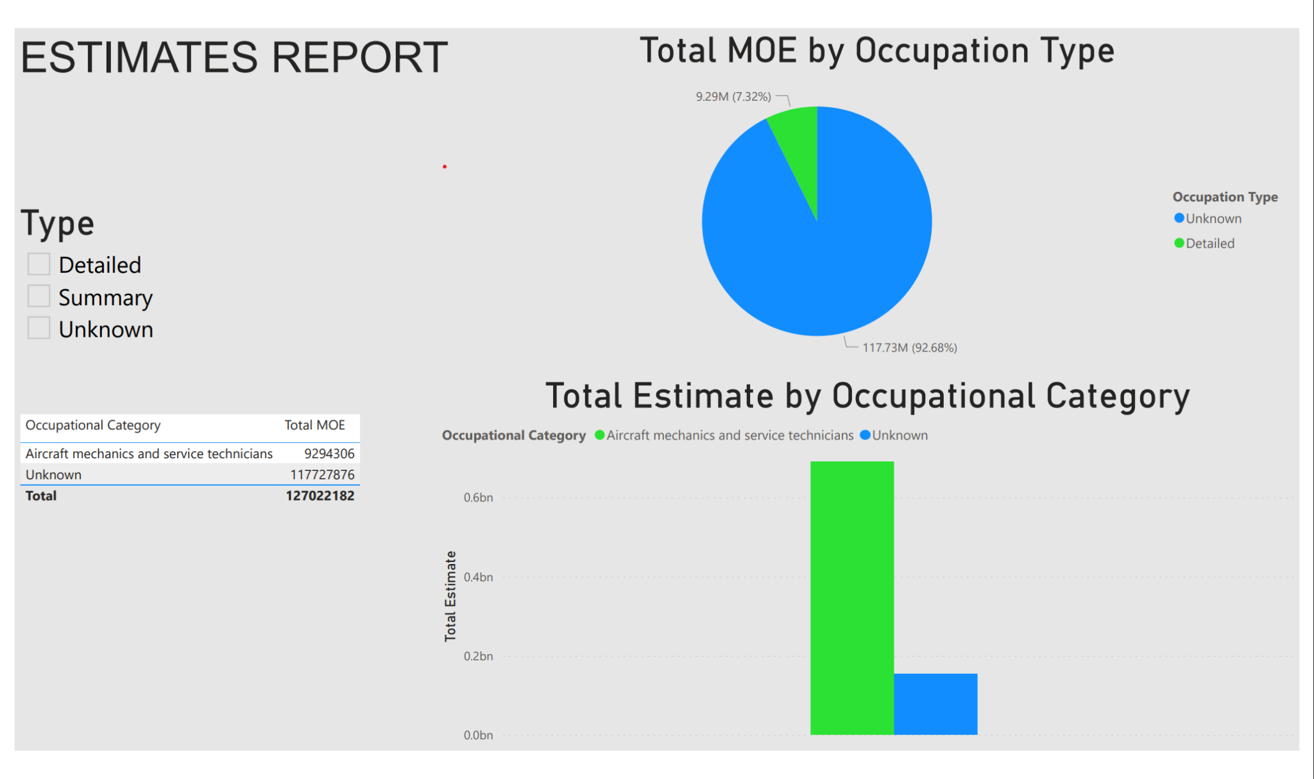
SSAS Design:

Slide 8
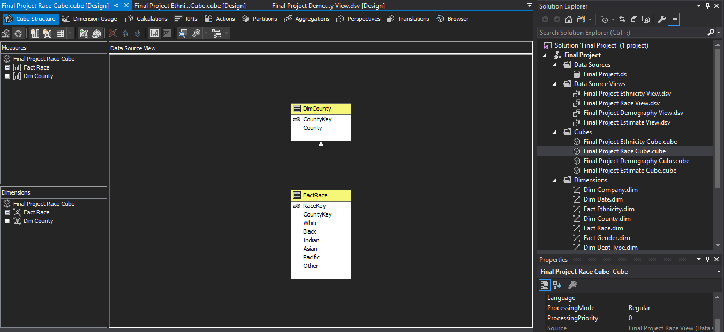
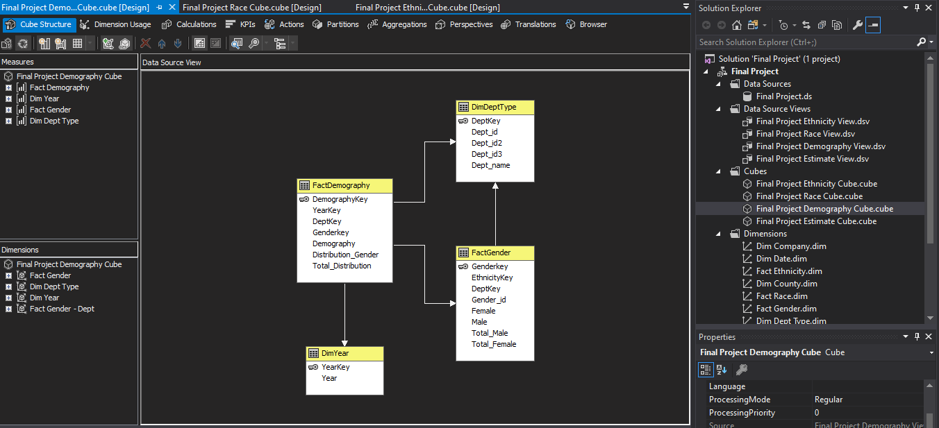
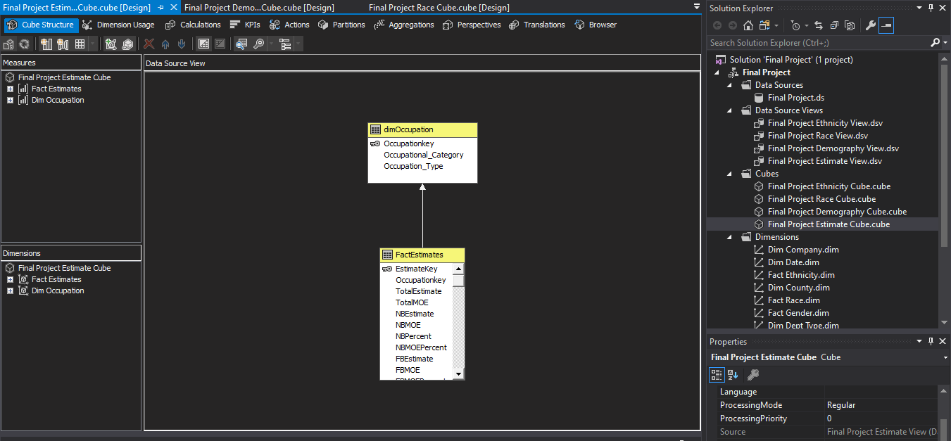
Cube:
Ethnicity, Race, Demography Cubes

Slide 9
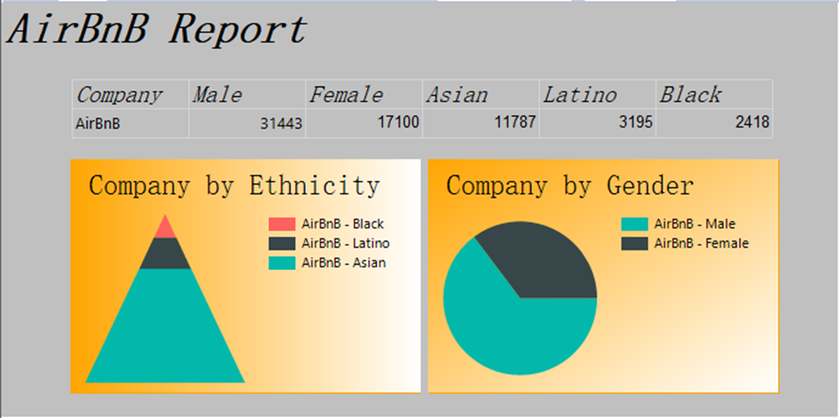
SQL Server Reporting Services SSRS
Ethnicity SSRS Report
SELECT factethnicity.male,
factethnicity.female,
factethnicity.asian,
factethnicity.latino,
factethnicity.black,
dimcompany.company
FROM dimcompany
INNER JOIN factethnicity
ON dimcompany.compkey = factethnicity.compkey
WHERE ( dimcompany.company = N'AirBnB' )
ORDER BY dimcompany.company
Script
Building the report

Slide 10
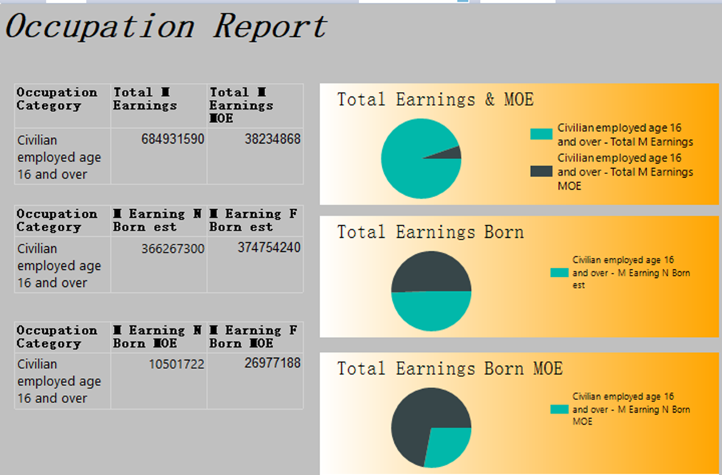
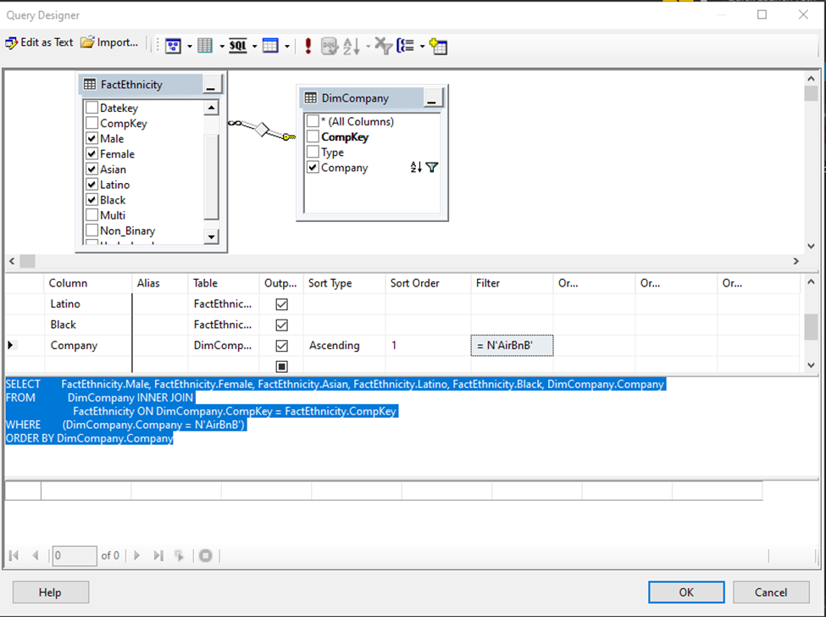
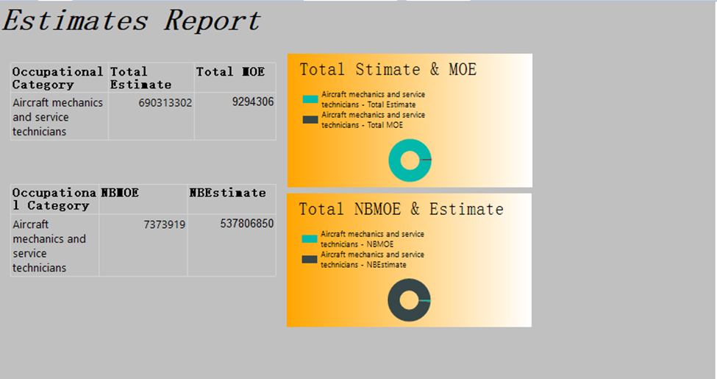
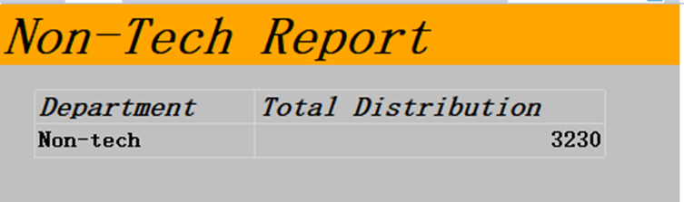
More Reports…
Creating the Script
Better performance
Friendly user
Advance Options

Slide 11
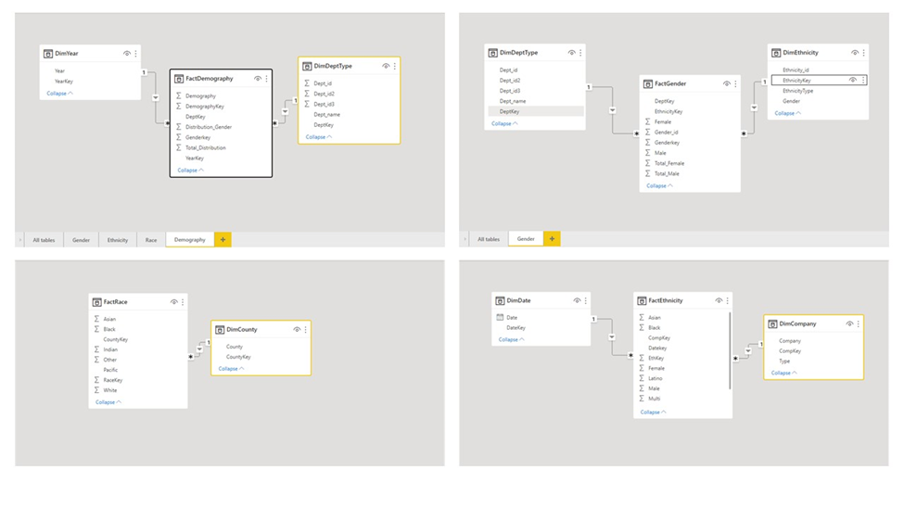
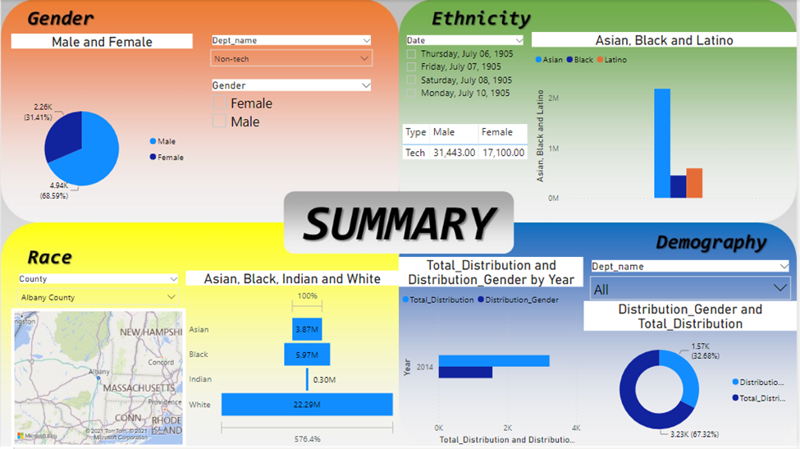
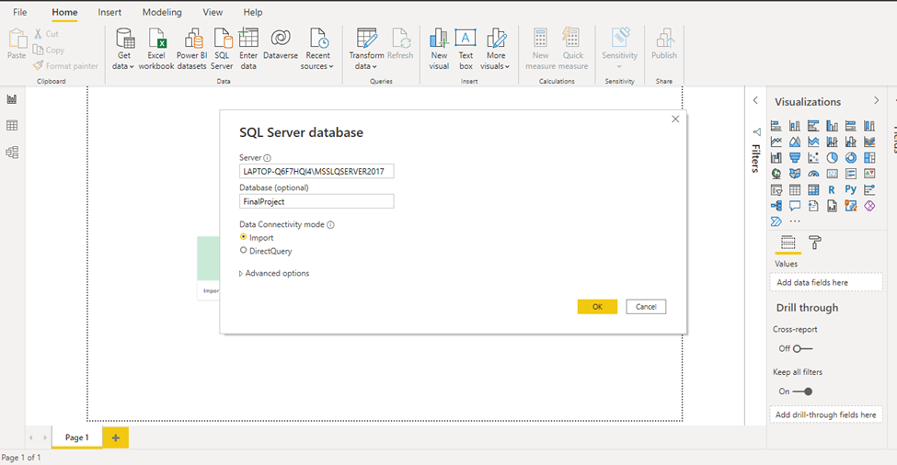
Power BI Reporting
Building the Relations
Friendly Software
Low Cost
AI visualization
New feature every month
Connecting SQL Database

Slide 12
Conclusion:
In conclusion, this project has projected the future employment trends with the past census data in employment in the areas of technology.
This project had helped cross reference and analyze the census data through ETL, SSIS, SSAS, and SSRS Reports.
Using the technical analysis made in this project it can help the future employment seekers in technology in New York from the minority in age, ethnicity, and gender.

Slide 13
References:
Microsoft (Ed.). (n.d.). What is SQL Server Reporting Services - SQL Server Reporting Services (SSRS). What is SQL Server Reporting Services - SQL Server Reporting Services (SSRS) | Microsoft Docs. Retrieved December 14, 2021, from https://docs.microsoft.com/en-us/sql/reporting-services/create-deploy-and-manage-mobile-and-paginated-reports?view=sql-server-ver15.
Mihart. (n.d.). What is Power Bi? - power bi. Power BI | Microsoft Docs. Retrieved December 14, 2021, from https://docs.microsoft.com/en-us/power-bi/fundamentals/power-bi-overview
Jaiswal, Sonoo. Data Warehouse Architecture. JavaPoint, from https://www.javatpoint.com/data-warehouse-architecture
Employment Census Data . Explore census data. (n.d.). Retrieved December 17, 2021, from https://data.census.gov/cedsci/all?q=employment

Slide 14
Thank you

